Slide 1

Parameter estimation of damped harmonic oscillator
Prof. Fedele Giuseppe
Student: Rustemova Aynura
Matricola: 234277

Slide 2
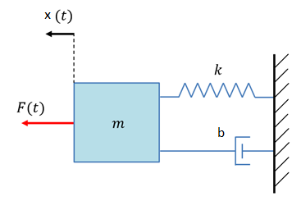
Description of the model
The mass-spring-damper system includes three basic elements:
mass - inertia element
spring - elastic element
damper – frictional element
Each of the elements has one of two possible energy behaviors:
stores all the energy supplied to it
dissipates all energy into heat by some kind of “frictional” effect

Slide 3
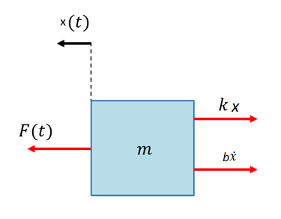
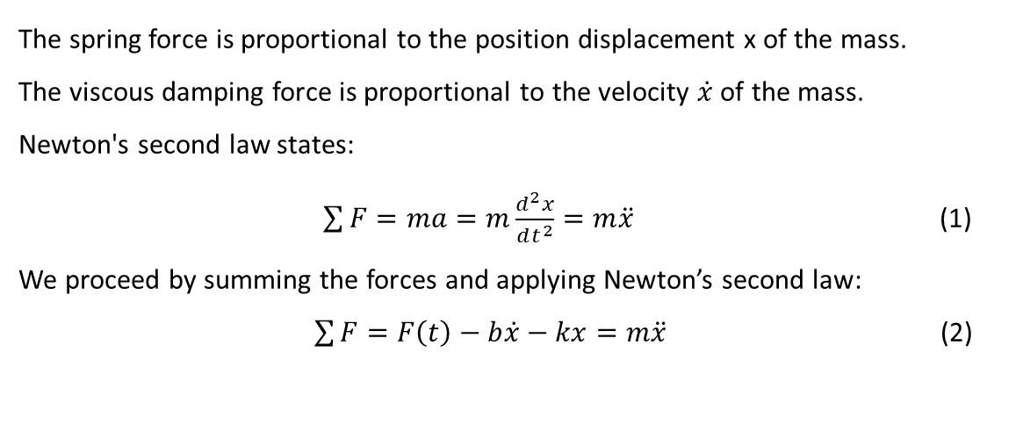
The mass stores energy as kinetic energy.
The spring stores energy as potential energy when it is compressed from its original length.
The damper dissipates energy as a heat.
These three components: mass, spring and damper, can model any dynamic response situation in a general sense.
The force diagram for this system is shown below.
The spring force is proportional to the position displacement x of the mass.
The viscous damping force is proportional to the velocity $\dot{x}$ of the mass.
Newton's second law states:
$\sum{F}=ma=m\frac{d^{2}x}{dt^{2}}=m\ddot{x}$ (1)
We proceed by summing the forces and applying Newton’s second law:
$\sum{F}=F\left(t\right)−b\dot{x}−kx=m\ddot{x}$ (2)
where:
x is the body position displacement
m is the body mass
F is the external force applied to the body
k is the spring constant
b is the damping coefficient

Slide 4
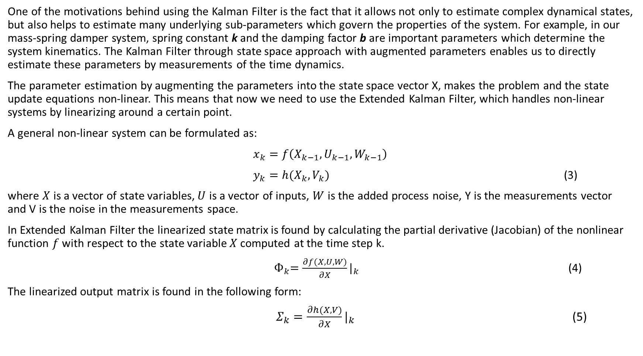
One of the motivations behind using the Kalman Filter is the fact that it allows not only to estimate complex dynamical states, but also helps to estimate many underlying sub-parameters which govern the properties of the system. For example, in our mass-spring damper system, spring constant k and the damping factor b are important parameters which determine the system kinematics. The Kalman Filter through state space approach with augmented parameters enables us to directly estimate these parameters by measurements of the time dynamics.
The parameter estimation by augmenting the parameters into the state space vector X, makes the problem and the state update equations non-linear. This means that now we need to use the Extended Kalman Filter, which handles non-linear systems by linearizing around a certain point.
A general non-linear system can be formulated as:
$x_{k}=f\left(X_{k−1},U_{k−1},W_{k−1}\right)$
$y_{k}=h(X_{k},V_{k})$ (3)
where $X$is a vector of state variables, $U$ is a vector of inputs, $W$ is the added process noise, Y is the measurements vector and V is the noise in the measurements space.
In Extended Kalman Filter the linearized state matrix is found by calculating the partial derivative (Jacobian) of the nonlinear function $f$ with respect to the state variable $X$ computed at the time step k.
${ Ф}_{k}=\frac{∂f(X,U,W)}{∂X}|_{k}$ (4)
The linearized output matrix is found in the following form:
$Σ_{k}=\frac{∂h(X,V)}{∂X}|_{k}$ (5)

Slide 5
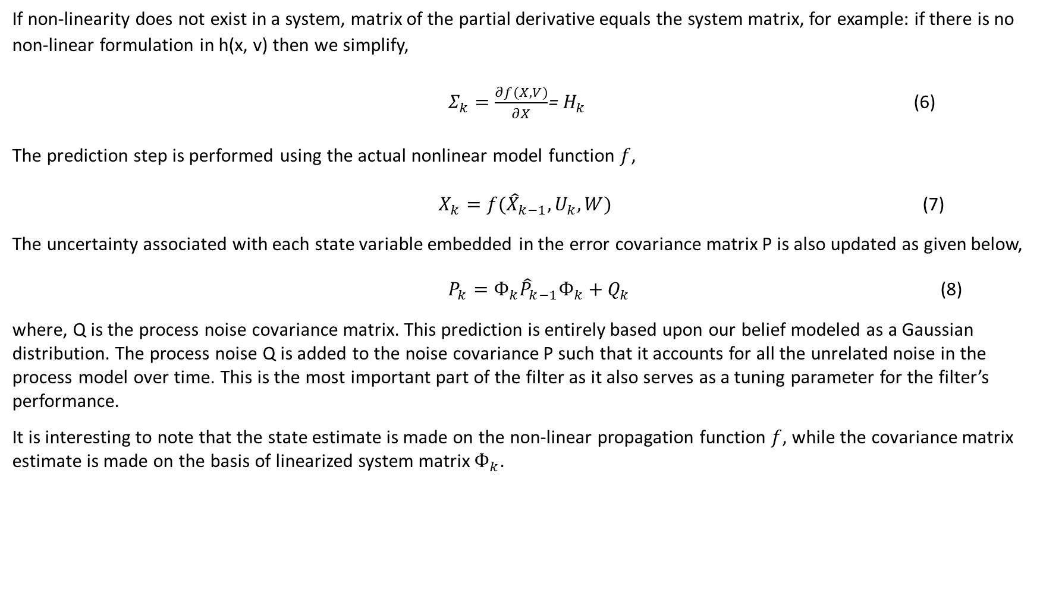
If non-linearity does not exist in a system, matrix of the partial derivative equals the system matrix, for example: if there is no non-linear formulation in h(x, v) then we simplify,
$Σ_{k}=\frac{∂f(X,V)}{∂X}$= $H_{k}$ (6)
The prediction step is performed using the actual nonlinear model function $f$,
$X_{k}=f({\hat{X}}_{k−1},U_{k},W)$ (7)
The uncertainty associated with each state variable embedded in the error covariance matrix P is also updated as given below,
$P_{k}=Ф_{k}{\hat{P}}_{k−1}Ф_{k}+Q_{k}$ (8)
where, Q is the process noise covariance matrix. This prediction is entirely based upon our belief modeled as a Gaussian distribution. The process noise Q is added to the noise covariance P such that it accounts for all the unrelated noise in the process model over time. This is the most important part of the filter as it also serves as a tuning parameter for the filter’s performance.
It is interesting to note that the state estimate is made on the non-linear propagation function $f$, while the covariance matrix estimate is made on the basis of linearized system matrix $Ф_{k}$.

Slide 6
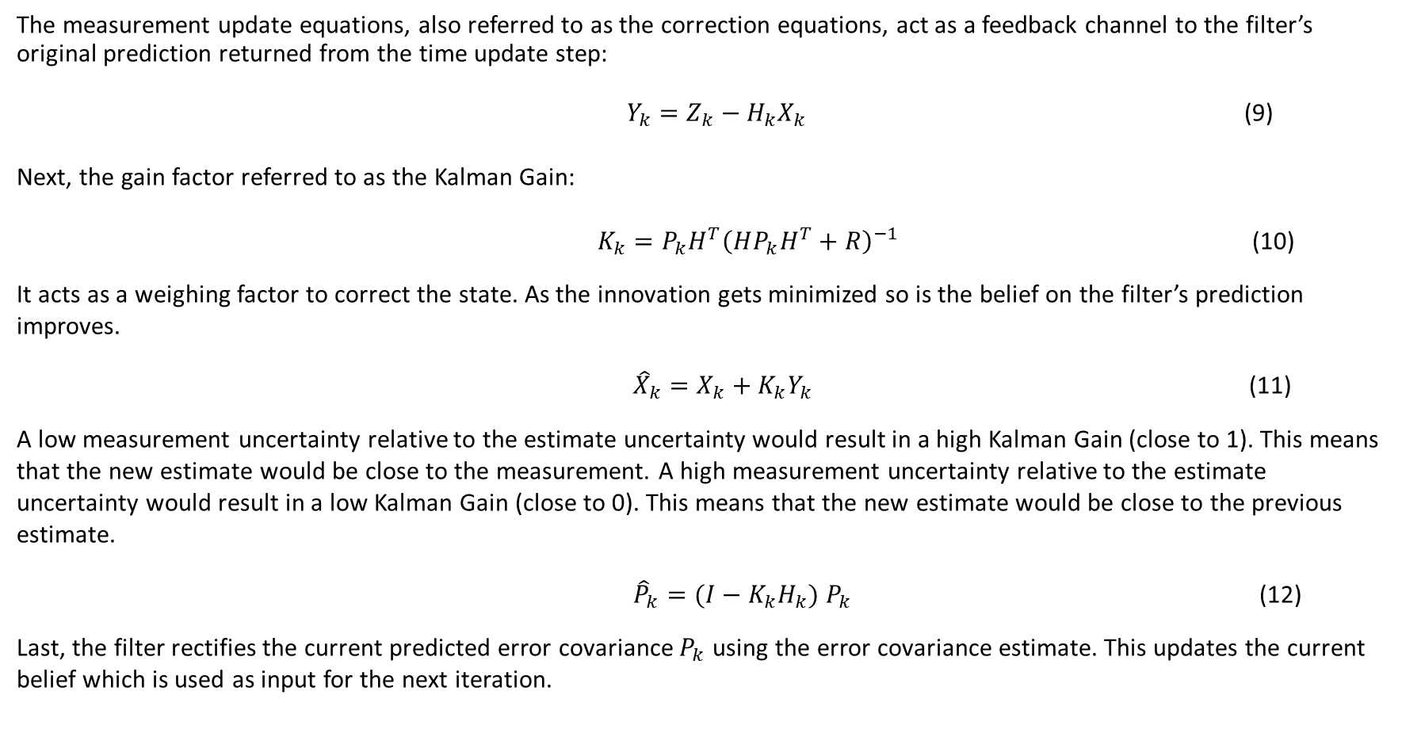
The measurement update equations, also referred to as the correction equations, act as a feedback channel to the filter’s original prediction returned from the time update step:
$Y_{k}=Z_{k}−H_{k}X_{k}$ (9)
Next, the gain factor referred to as the Kalman Gain:
$K_{k}=P_{k}H^{T}{\left(HP_{k}H^{T}+R\right)}^{−1}$ (10)
It acts as a weighing factor to correct the state. As the innovation gets minimized so is the belief on the filter’s prediction improves.
${\hat{X}}_{k}=X_{k}+K_{k}Y_{k}$ (11)
A low measurement uncertainty relative to the estimate uncertainty would result in a high Kalman Gain (close to 1). This means that the new estimate would be close to the measurement. A high measurement uncertainty relative to the estimate uncertainty would result in a low Kalman Gain (close to 0). This means that the new estimate would be close to the previous estimate.
${\hat{P}}_{k}=(I−K_{k}H_{k}) P_{k}$ (12)
Last, the filter rectifies the current predicted error covariance $P_{k}$ using the error covariance estimate. This updates the current belief which is used as input for the next iteration.

Slide 7
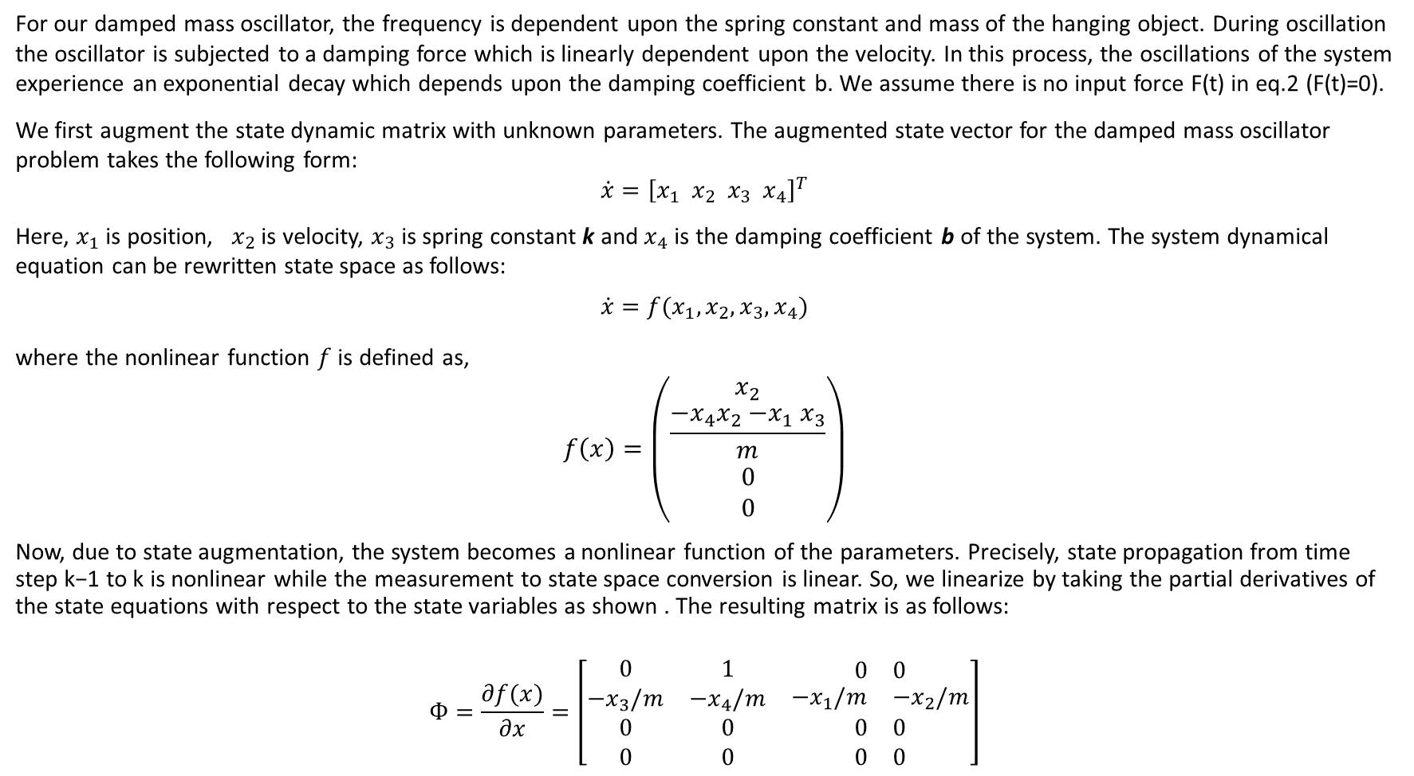
For our damped mass oscillator, the frequency is dependent upon the spring constant and mass of the hanging object. During oscillation the oscillator is subjected to a damping force which is linearly dependent upon the velocity. In this process, the oscillations of the system experience an exponential decay which depends upon the damping coefficient b. We assume there is no input force F(t) in eq.2 (F(t)=0).
We first augment the state dynamic matrix with unknown parameters. The augmented state vector for the damped mass oscillator problem takes the following form:
$$\dot{x}={\left[x_{1}{ x}_{2} x_{3}{ x}_{4}\right]}^{T}$$
Here, $x_{1}$ is position, ${ x}_{2}$ is velocity, $x_{3}$ is spring constant k and $x_{4}$ is the damping coefficient b of the system. The system dynamical equation can be rewritten state space as follows:
$$\dot{x}=f(x_{1},x_{2},x_{3},x_{4})$$
where the nonlinear function $f$ is defined as,
$$f\left(x\right)=\left(\begin{matrix}x_{2} \\ \frac{{−x}_{4}x_{2}{−x}_{1}x_{3}}{m} \\ \begin{matrix}0 \\ 0\end{matrix}\end{matrix}\right)$$
Now, due to state augmentation, the system becomes a nonlinear function of the parameters. Precisely, state propagation from time step k−1 to k is nonlinear while the measurement to state space conversion is linear. So, we linearize by taking the partial derivatives of the state equations with respect to the state variables as shown . The resulting matrix is as follows:
$$Ф=\frac{∂f(x)}{∂x}=\left[\begin{matrix}0 & 1 & \begin{matrix}0 & 0\end{matrix} \\ {−x}_{3}/m & {−x}_{4}/m & \begin{matrix}{−x}_{1}/m & −x_{2}/m\end{matrix} \\ \begin{matrix}0 \\ 0\end{matrix} & \begin{matrix}0 \\ 0\end{matrix} & \begin{matrix}\begin{matrix}0 \\ 0\end{matrix} & \begin{matrix}0 \\ 0\end{matrix}\end{matrix}\end{matrix}\right]$$

Slide 8

From $Ф$ we derive the discretized state transfer matrix :
$$F=e^{Ф∆t}≈I+Ф∆t≈\left[\begin{matrix}\begin{matrix}1 \\ {−x}_{3}∆t/m\end{matrix} & \begin{matrix}∆t \\ (1{−x}_{4}∆t)/m\end{matrix} & \begin{matrix}\begin{matrix}0 & 0\end{matrix} \\ \begin{matrix}{−x}_{1}∆t/m & {−x}_{2}∆t/m\end{matrix}\end{matrix} \\ 0 & 0 & \begin{matrix}1 & 0\end{matrix} \\ 0 & 0 & \begin{matrix}0 & 1\end{matrix}\end{matrix}\right]$$
If only the position is being measured, the measurement matrix is
$$H=\left[\begin{matrix}1 & 0 & \begin{matrix}0 & 0\end{matrix}\end{matrix}\right]$$

Slide 9
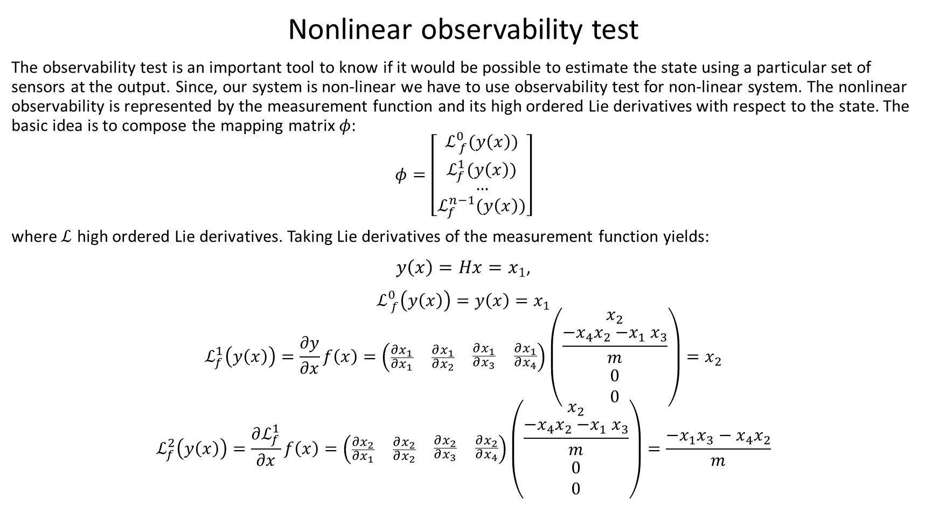
Nonlinear observability test
The observability test is an important tool to know if it would be possible to estimate the state using a particular set of sensors at the output. Since, our system is non-linear we have to use observability test for non-linear system. The nonlinear observability is represented by the measurement function and its high ordered Lie derivatives with respect to the state. The basic idea is to compose the mapping matrix $φ$:
$$φ=\left[\begin{matrix}ℒ_{ f}^{0}(y\left(x\right)) \\ ℒ_{f}^{1}(y\left(x\right)) \\ \begin{matrix}… \\ ℒ_{f}^{n−1}(y\left(x\right))\end{matrix}\end{matrix}\right]$$
where$ℒ$ high ordered Lie derivatives. Taking Lie derivatives of the measurement function yields:
$y\left(x\right)=Hx=x_{1}$,
$ℒ_{ f}^{0}\left(y\left(x\right)\right)=y\left(x\right)=x_{1}$
$$ℒ_{f}^{1}\left(y\left(x\right)\right)=\frac{∂y}{∂x}f\left(x\right)=\left(\begin{matrix}\frac{∂x_{1}}{∂x_{1}} & \frac{∂x_{1}}{∂x_{2}} & \begin{matrix}\frac{∂x_{1}}{∂x_{3}} & \frac{∂x_{1}}{∂x_{4}}\end{matrix}\end{matrix}\right)\left(\begin{matrix}x_{2} \\ \frac{{−x}_{4}x_{2}{−x}_{1}x_{3}}{m} \\ \begin{matrix}0 \\ 0\end{matrix}\end{matrix}\right)=x_{2}$$
$$ℒ_{f}^{2}\left(y\left(x\right)\right)=\frac{∂ℒ_{f}^{1}}{∂x}f\left(x\right)=\left(\begin{matrix}\frac{∂x_{2}}{∂x_{1}} & \frac{∂x_{2}}{∂x_{2}} & \begin{matrix}\frac{∂x_{2}}{∂x_{3}} & \frac{∂x_{2}}{∂x_{4}}\end{matrix}\end{matrix}\right)\left(\begin{matrix}x_{2} \\ \frac{{−x}_{4}x_{2}{−x}_{1}x_{3}}{m} \\ \begin{matrix}0 \\ 0\end{matrix}\end{matrix}\right)=\frac{{{−x}_{1}x_{3}−x}_{4}x_{2}}{m}$$

Slide 10
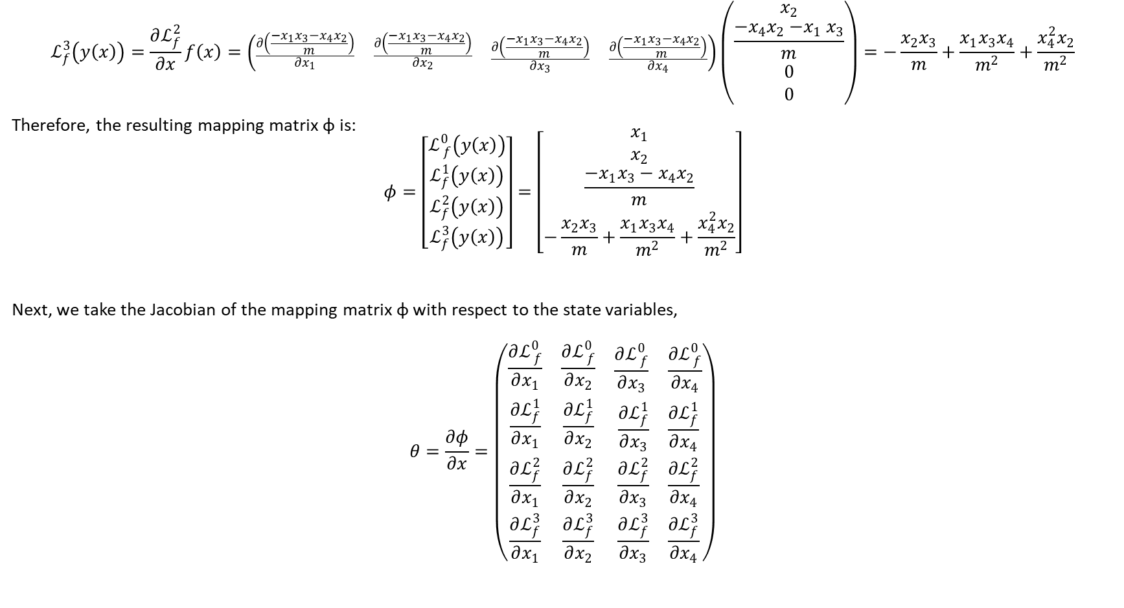
$$ℒ_{f}^{3}\left(y\left(x\right)\right)=\frac{∂ℒ_{f}^{2}}{∂x}f\left(x\right)=\left(\begin{matrix}\frac{∂\left(\frac{{{−x}_{1}x_{3}−x}_{4}x_{2}}{m}\right)}{∂x_{1}} & \frac{∂\left(\frac{{{−x}_{1}x_{3}−x}_{4}x_{2}}{m}\right)}{∂x_{2}} & \begin{matrix}\frac{∂\left(\frac{−{x_{1}x_{3}−x}_{4}x_{2}}{m}\right)}{∂x_{3}} & \frac{∂\left(\frac{−{x_{1}x_{3}−x}_{4}x_{2}}{m}\right)}{∂x_{4}}\end{matrix}\end{matrix}\right)\left(\begin{matrix}x_{2} \\ \frac{{−x}_{4}x_{2}{−x}_{1}x_{3}}{m} \\ \begin{matrix}0 \\ 0\end{matrix}\end{matrix}\right)=−\frac{x_{2}x_{3}}{m}+\frac{x_{1}x_{3}x_{4}}{m^{2}}+\frac{x_{4}^{2}x_{2}}{m^{2}}$$
Therefore, the resulting mapping matrix φ is:
$$φ=\left[\begin{matrix}ℒ_{ f}^{0}\left(y\left(x\right)\right) \\ ℒ_{f}^{1}\left(y\left(x\right)\right) \\ \begin{matrix}ℒ_{f}^{2}\left(y\left(x\right)\right) \\ ℒ_{f}^{3}\left(y\left(x\right)\right)\end{matrix}\end{matrix}\right]=\left[\begin{matrix}x_{1} \\ x_{2} \\ \begin{matrix}\frac{{{−x}_{1}x_{3}−x}_{4}x_{2}}{m} \\ −\frac{x_{2}x_{3}}{m}+\frac{x_{1}x_{3}x_{4}}{m^{2}}+\frac{x_{4}^{2}x_{2}}{m^{2}}\end{matrix}\end{matrix}\right]$$
Next, we take the Jacobian of the mapping matrix φ with respect to the state variables,
$$θ=\frac{∂φ}{∂x}=\left(\begin{matrix}\frac{∂ℒ_{ f}^{0}}{∂x_{1}} & \frac{∂ℒ_{ f}^{0}}{∂x_{2}} & \begin{matrix}\frac{∂ℒ_{ f}^{0}}{∂x_{3}} & \frac{∂ℒ_{ f}^{0}}{∂x_{4}}\end{matrix} \\ \frac{{∂ℒ}_{f}^{1}}{∂x_{1}} & \frac{{∂ℒ}_{f}^{1}}{∂x_{2}} & \begin{matrix}\frac{{∂ℒ}_{f}^{1}}{∂x_{3}} & \frac{{∂ℒ}_{f}^{1}}{∂x_{4}}\end{matrix} \\ \begin{matrix}\frac{∂ℒ_{f}^{2}}{∂x_{1}} \\ \frac{∂ℒ_{f}^{3}}{∂x_{1}}\end{matrix} & \begin{matrix}\frac{∂ℒ_{f}^{2}}{∂x_{2}} \\ \frac{∂ℒ_{f}^{3}}{∂x_{2}}\end{matrix} & \begin{matrix}\begin{matrix}\frac{∂ℒ_{f}^{2}}{∂x_{3}} \\ \frac{∂ℒ_{f}^{3}}{∂x_{3}}\end{matrix} & \begin{matrix}\frac{∂ℒ_{f}^{2}}{∂x_{4}} \\ \frac{∂ℒ_{f}^{3}}{∂x_{4}}\end{matrix}\end{matrix}\end{matrix}\right)$$

Slide 11

This results in the following nonlinear observability test matrix for the augmented parameter estimation of the damped harmonic oscillator model using only a position sensor
$$θ=\left(\begin{matrix}1 & 0 & \begin{matrix}0 & 0\end{matrix} \\ 0 & 1 & \begin{matrix}0 & 0\end{matrix} \\ \begin{matrix}−x_{3}/m \\ x_{3}x_{4}/m^{2}\end{matrix} & \begin{matrix}−x_{4}/m \\ (x_{4}^{2}−x_{3}m)/m^{2}\end{matrix} & \begin{matrix}\begin{matrix}−x_{1}/m \\ (x_{1}x_{4}−x_{2}m)/m^{2}\end{matrix} & \begin{matrix}−x_{2}/m \\ (x_{1}x_{3}+2x_{4})/m^{2}\end{matrix}\end{matrix}\end{matrix}\right)$$
The rank of this observability matrix is equal to the dimensions of the system i.e. n = 4. This means that this is observable.

Slide 12
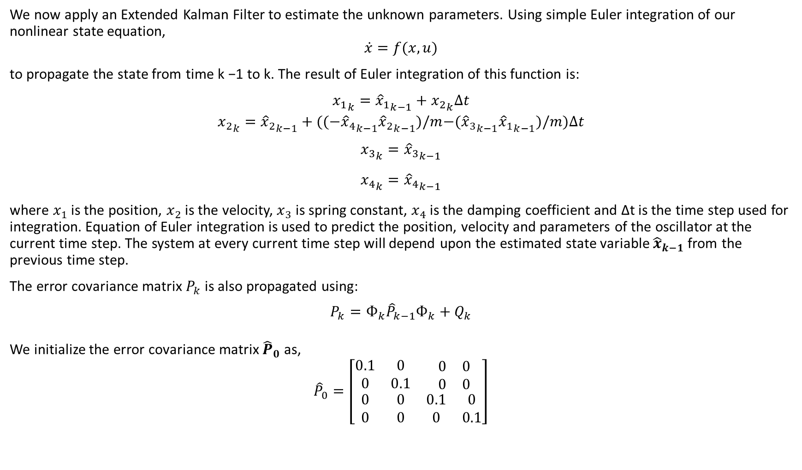
We now apply an Extended Kalman Filter to estimate the unknown parameters. Using simple Euler integration of our nonlinear state equation,
$$\dot{x}=f(x,u)$$
to propagate the state from time k −1 to k. The result of Euler integration of this function is:
$${x_{1}}_{k}={{\hat{x}}_{1}}_{k−1}+{x_{2}}_{k}∆t$$
$${x_{2}}_{k}={{\hat{x}}_{2}}_{k−1}+({{(−\hat{x}}_{4}}_{k−1}{{\hat{x}}_{2}}_{k−1})/m{{−(\hat{x}}_{3}}_{k−1}{{\hat{x}}_{1}}_{k−1})/m)∆t$$
$${x_{3}}_{k}={{\hat{x}}_{3}}_{k−1}$$
$${x_{4}}_{k}={{\hat{x}}_{4}}_{k−1}$$
where $x_{1}$ is the position, $x_{2}$ is the velocity, $x_{3}$ is spring constant, $x_{4}$ is the damping coefficient and ∆t is the time step used for integration. Equation of Euler integration is used to predict the position, velocity and parameters of the oscillator at the current time step. The system at every current time step will depend upon the estimated state variable ${\hat{x}}_{k−1}$ from the previous time step.
The error covariance matrix $P_{k}$ is also propagated using:
$$P_{k}=Ф_{k}{\hat{P}}_{k−1}Ф_{k}+Q_{k}$$
We initialize the error covariance matrix ${\hat{P}}_{0}$ as,
$${\hat{P}}_{0}=\left[\begin{matrix}0.1 & 0 & \begin{matrix}0 & 0\end{matrix} \\ 0 & 0.1 & \begin{matrix}0 & 0\end{matrix} \\ \begin{matrix}0 \\ 0\end{matrix} & \begin{matrix}0 \\ 0\end{matrix} & \begin{matrix}\begin{matrix}0.1 \\ 0\end{matrix} & \begin{matrix}0 \\ 0.1\end{matrix}\end{matrix}\end{matrix}\right]$$

Slide 13
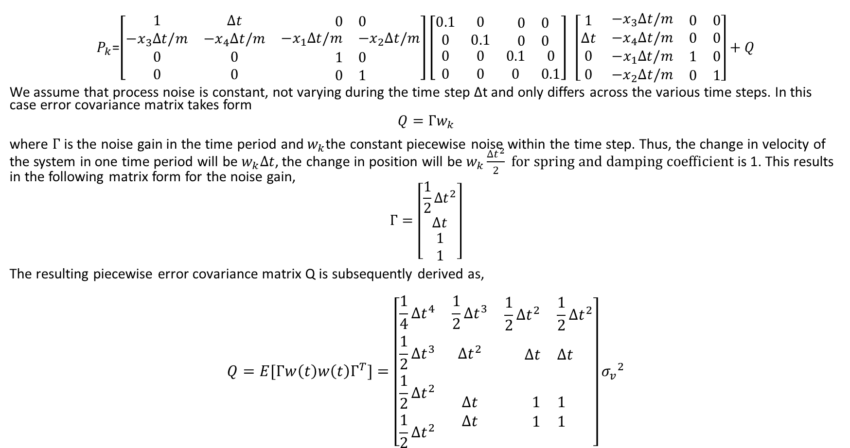
$P_{k}$=$\left[\begin{matrix}\begin{matrix}1 \\ {−x}_{3}∆t/m\end{matrix} & \begin{matrix}∆t \\ −x_{4}∆t/m\end{matrix} & \begin{matrix}\begin{matrix}0 & 0\end{matrix} \\ \begin{matrix}{−x}_{1}∆t/m & {−x}_{2}∆t/m\end{matrix}\end{matrix} \\ 0 & 0 & \begin{matrix}1 & 0\end{matrix} \\ 0 & 0 & \begin{matrix}0 & 1\end{matrix}\end{matrix}\right]\left[\begin{matrix}0.1 & 0 & \begin{matrix}0 & 0\end{matrix} \\ 0 & 0.1 & \begin{matrix}0 & 0\end{matrix} \\ \begin{matrix}0 \\ 0\end{matrix} & \begin{matrix}0 \\ 0\end{matrix} & \begin{matrix}\begin{matrix}0.1 \\ 0\end{matrix} & \begin{matrix}0 \\ 0.1\end{matrix}\end{matrix}\end{matrix}\right] \left[\begin{matrix}\begin{matrix}1 \\ ∆t\end{matrix} & \begin{matrix}{−x}_{3}∆t/m \\ −x_{4}∆t/m\end{matrix} & \begin{matrix}\begin{matrix}0 & 0\end{matrix} \\ \begin{matrix}0 & 0\end{matrix}\end{matrix} \\ 0 & {−x}_{1}∆t/m & \begin{matrix}1 & 0\end{matrix} \\ 0 & {−x}_{2}∆t/m & \begin{matrix}0 & 1\end{matrix}\end{matrix}\right]+Q$
We assume that process noise is constant, not varying during the time step ∆t and only differs across the various time steps. In this case error covariance matrix takes form
$$Q=Гw_{k}$$
where $Г$ is the noise gain in the time period and${ w}_{k}$the constant piecewise noise within the time step. Thus, the change in velocity of the system in one time period will be $w_{k}∆t$, the change in position will be $w_{k}\frac{{∆t}^{2}}{2} for spring and damping coefficient$is 1. This results in the following matrix form for the noise gain,
$$Г=\left[\begin{matrix}\frac{1}{2}∆t^{2} \\ ∆t \\ \begin{matrix}1 \\ 1\end{matrix}\end{matrix}\right]$$
The resulting piecewise error covariance matrix Q is subsequently derived as,
$$Q=E[Г{w\left(t\right)w\left(t\right)Г}^{T}]=\left[\begin{matrix}\frac{1}{4}∆t^{4} & \frac{1}{2}∆t^{3} & \begin{matrix}\frac{1}{2}∆t^{2} & \frac{1}{2}∆t^{2}\end{matrix} \\ \frac{1}{2}∆t^{3} & ∆t^{2} & \begin{matrix}∆t & ∆t\end{matrix} \\ \begin{matrix}\frac{1}{2}∆t^{2} \\ \frac{1}{2}∆t^{2}\end{matrix} & \begin{matrix}∆t \\ ∆t\end{matrix} & \begin{matrix}\begin{matrix}1 \\ 1\end{matrix} & \begin{matrix}1 \\ 1\end{matrix}\end{matrix}\end{matrix}\right]{σ_{v}}^{2}$$

Slide 14
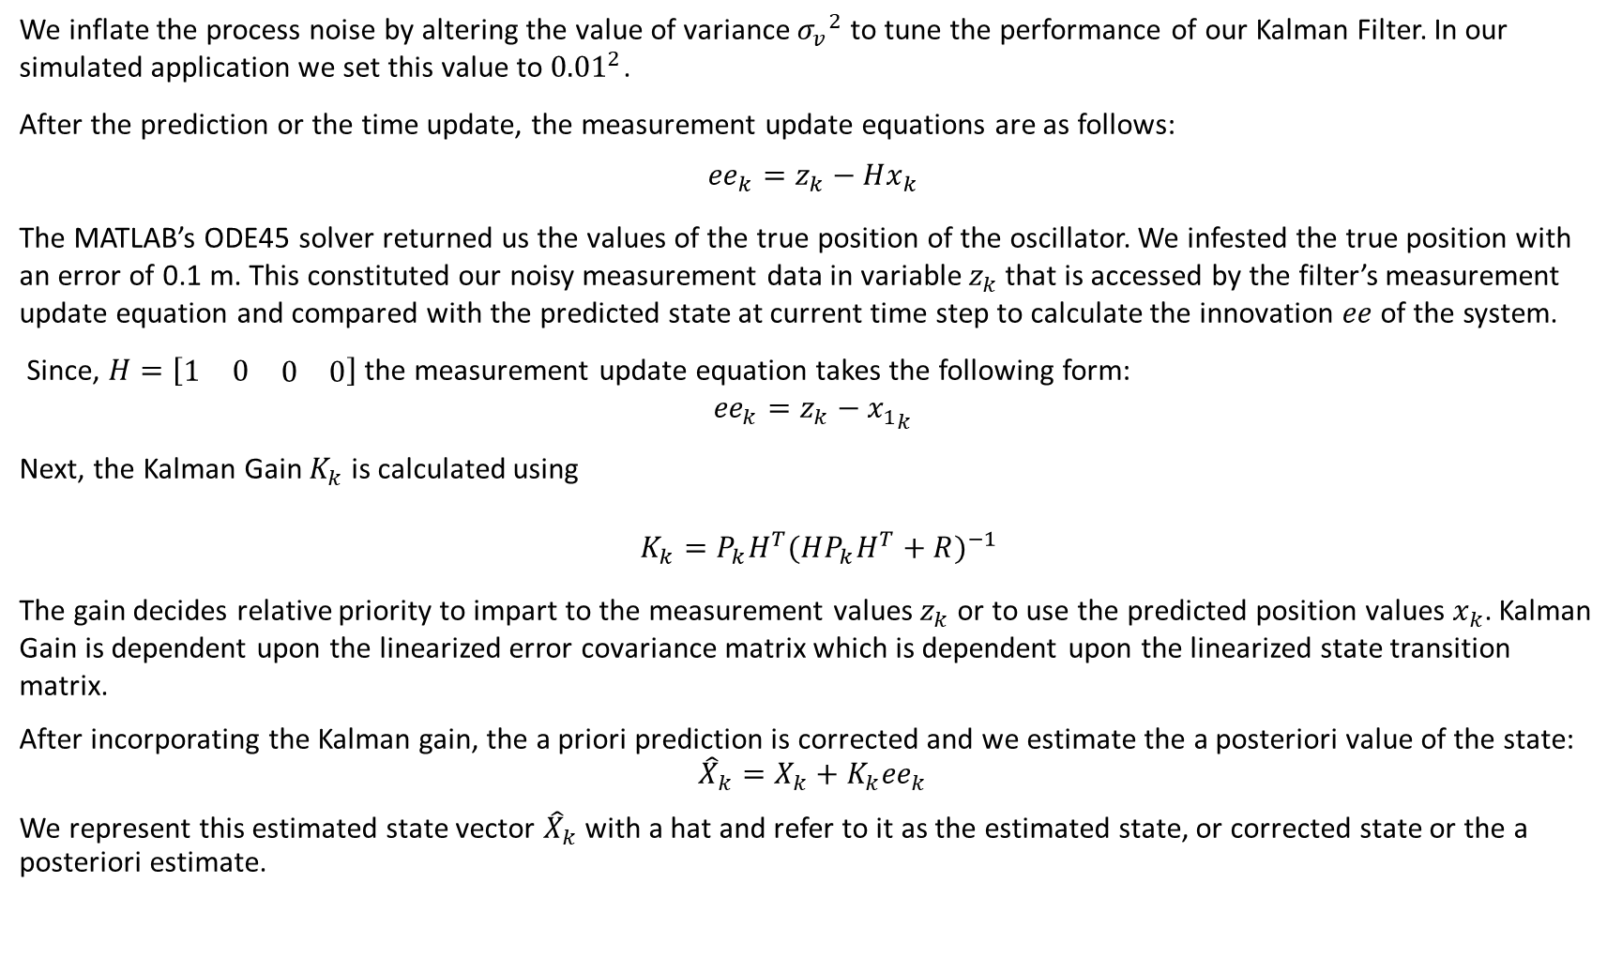
We inflate the process noise by altering the value of variance ${σ_{v}}^{2}$ to tune the performance of our Kalman Filter. In our simulated application we set this value to ${0.01}^{2}$.
After the prediction or the time update, the measurement update equations are as follows:
$${ee}_{k}=z_{k}−Hx_{k}$$
The MATLAB’s ODE45 solver returned us the values of the true position of the oscillator. We infested the true position with an error of 0.1 m. This constituted our noisy measurement data in variable $z_{k}$ that is accessed by the filter’s measurement update equation and compared with the predicted state at current time step to calculate the innovation $ee$of the system.
Since, $H=\left[\begin{matrix}1 & 0 & \begin{matrix}0 & 0\end{matrix}\end{matrix}\right]$ the measurement update equation takes the following form:
$${ee}_{k}=z_{k}−{x_{1}}_{k}$$
Next, the Kalman Gain $K_{k}$ is calculated using
$K_{k}=P_{k}H^{T}{(HP_{k}H^{T}+R)}^{−1}$
The gain decides relative priority to impart to the measurement values $z_{k}$ or to use the predicted position values $x_{k}$. Kalman Gain is dependent upon the linearized error covariance matrix which is dependent upon the linearized state transition matrix.
After incorporating the Kalman gain, the a priori prediction is corrected and we estimate the a posteriori value of the state:
$${\hat{X}}_{k}=X_{k}+K_{k}{ee}_{k}$$
We represent this estimated state vector ${\hat{X}}_{k}$ with a hat and refer to it as the estimated state, or corrected state or the a posteriori estimate.

Slide 15

Last, the filter rectifies the current predicted error covariance $P_{k}$ using the error covariance estimate equation:
$${\hat{P}}_{k}=(I−K_{k}H_{k})P_{k}$$
This updates the current belief which is used as input for the next iteration.
So, our state augmented nonlinear system for parameter estimation evolves with consideration of the uncertainties in the states and parameters to give us optimum estimated state outputs from the filter.

Slide 16
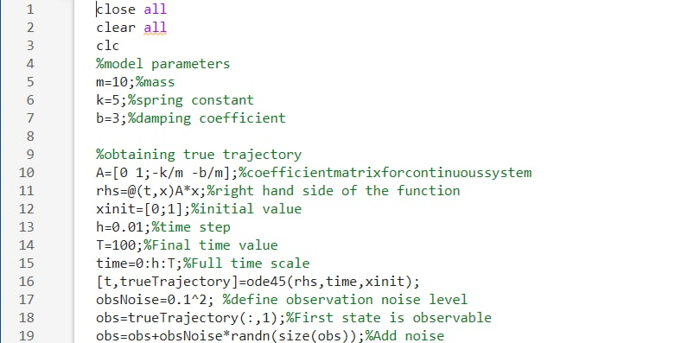
Matlab code

Slide 17
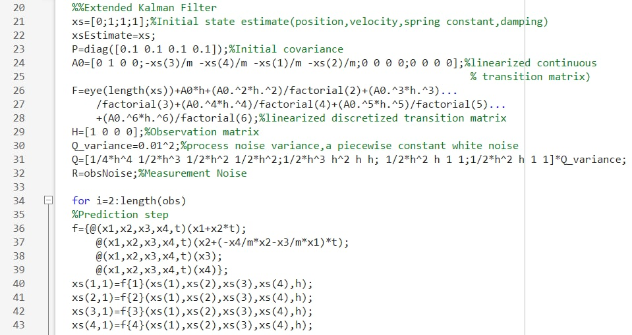

Slide 18
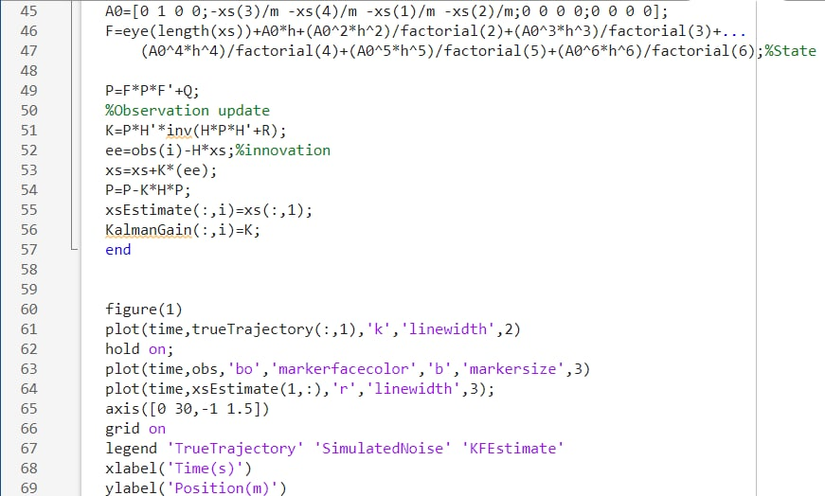

Slide 19
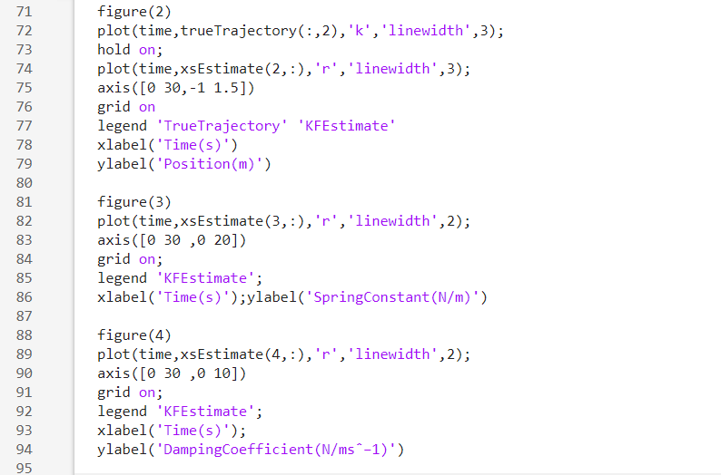

Slide 20
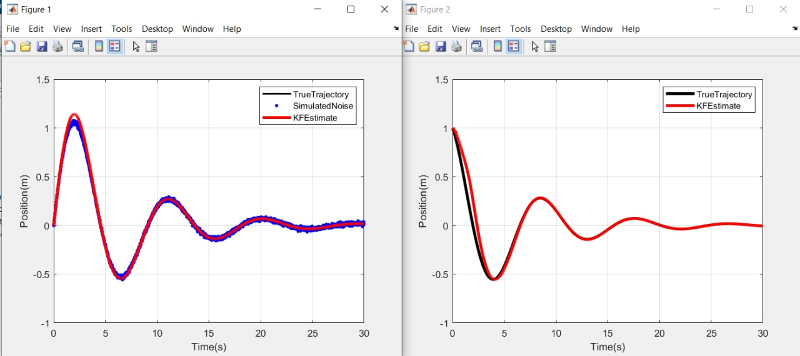

Slide 21
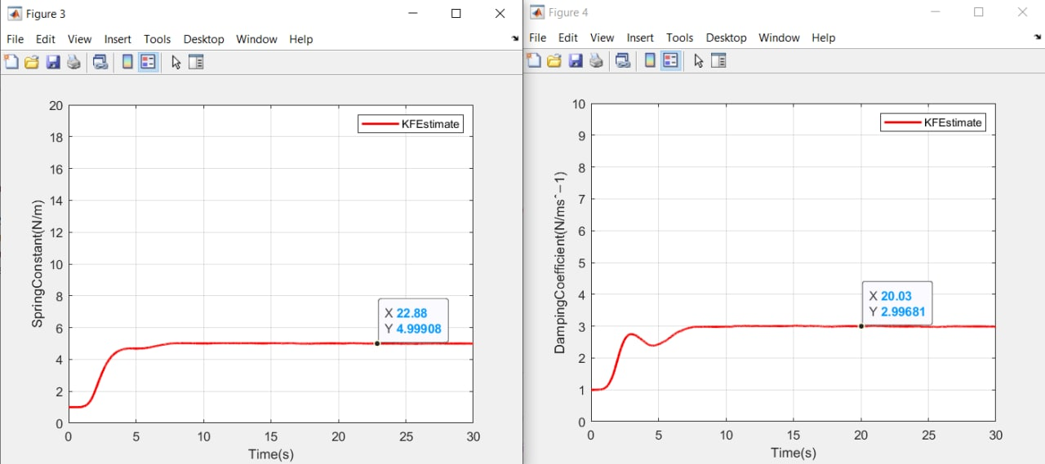

Slide 22
Conclusion
The abovementioned simulation of the joint state and parameter estimation of a damped mass spring system using Extended Kalman Filter. Figure(1) shows the simulated noisy position with the output of the filter’s estimates KF Estimate. Figure (2) shows the true simulated and estimated velocity of the system through the process model of the filter. Figure (3) shows the estimated value of the spring constant, the true value was 5 N/m. Figure (4) shows the estimated value of the damping coefficient with true value 3 Ns/m.
The filter successfully estimates the spring constant and the damping coefficient of the system.

Slide 23
Bibliography
https://www.intechopen.com/chapters/63164
https://www.kalmanfilter.net/default.aspx
“Model identification and data analysis”, Sergio Bittanti.

